Slide 1
COVID-19 Clinical Trials Dataset: Exploratory Data Analysis (EDA)
Domain: Healthcare Analytics / Clinical Research Tools Used: Python (Pandas, Matplotlib)

Slide 2
Project Objective
Main Objectives
Analyze global clinical trials conducted for COVID-19
Study trial status distribution (Recruiting, Completed, etc.)
Explore clinical trial phases and study designs
Identify top countries and sponsors leading COVID research
Visualize key insights using Python-based EDA techniques

Slide 3
Dataset Overview
Dataset Summary
Total Trials: 5,783 clinical studies
Total Variables: 27 features
Dataset includes:
Trial identification (NCT Number, Title)
Status and results
Conditions and interventions
Phase, enrollment, study type
Sponsors, locations, and timelines
Source: ClinicalTrials.gov

Slide 4
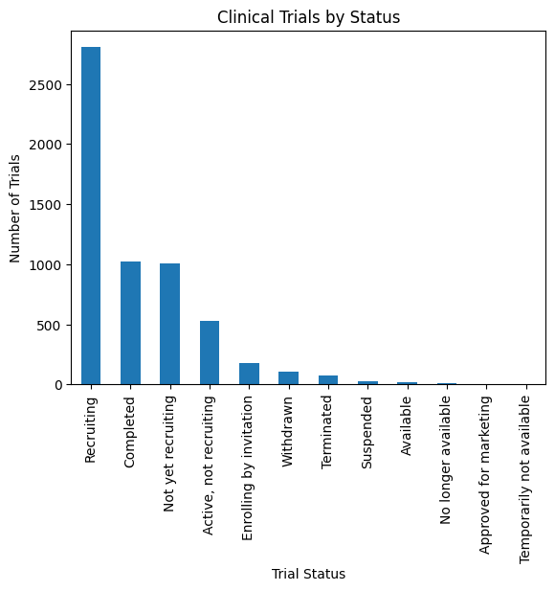
Trials by Status (Chart)
Status Distribution Analysis
A bar chart was created to observe trial progress.
Key Status Categories:
Recruiting
Completed
Not yet recruiting
Active, not recruiting
Insight: Most trials are still in the Recruiting stage, showing ongoing global research efforts.

Slide 5
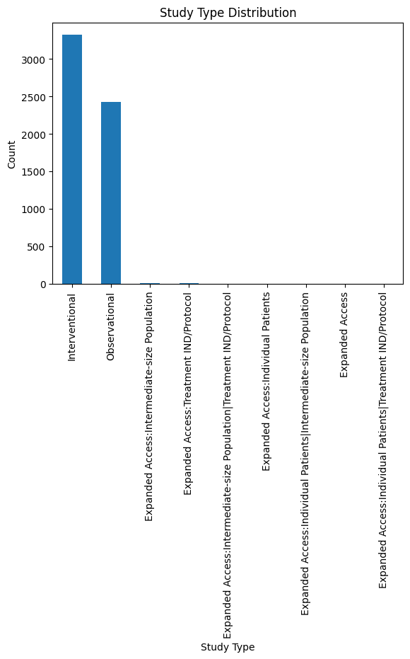
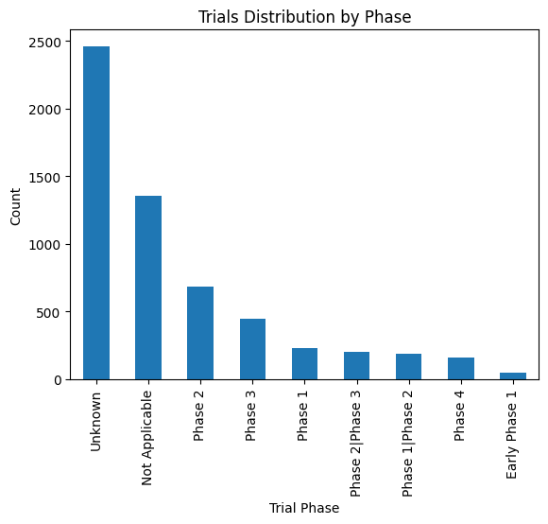
Trials by Phase
Clinical Trial Phase Analysis
Trials were grouped by phase:
Phase 1
Phase 2
Phase 3
Phase 4
Unknown
Insight: A large number of studies belong to Phase 2 and Phase 3, indicating advanced-stage vaccine and treatment testing.

Slide 6
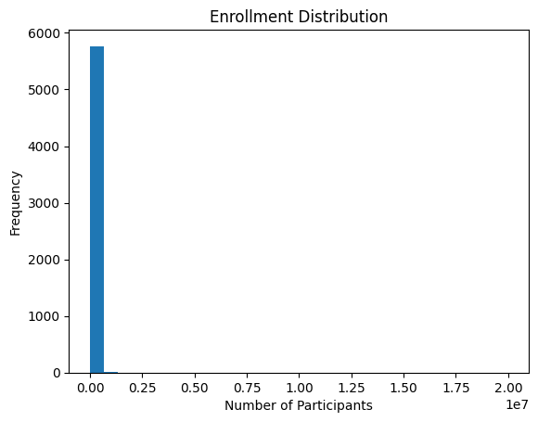
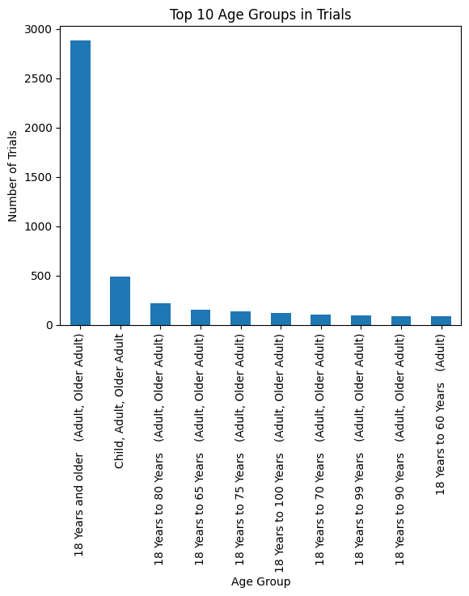
Enrollment Distribution
Participant Enrollment Analysis
Histogram analysis was performed on trial enrollment numbers.
Insight:
Many studies involve small-to-medium participant groups
Few large-scale trials include thousands of participants
Enrollment size reflects trial scope and study type

Slide 7
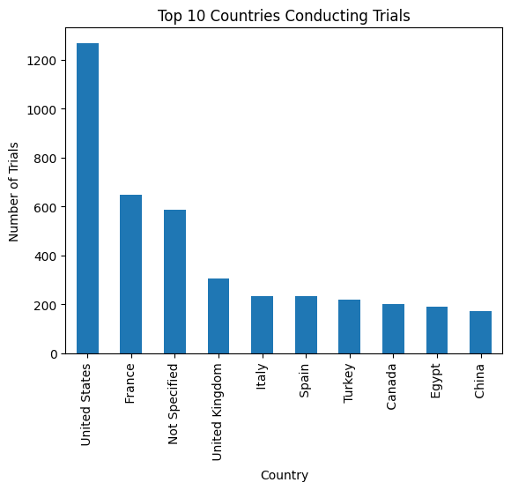
Top Countries Conducting Trials
Geographical Distribution
Trials were analyzed based on study locations.
Top contributing countries include:
USA
China
India
Italy
France
Insight:COVID research is globally distributed, with major contributions from developed and high-population countries.

Slide 8
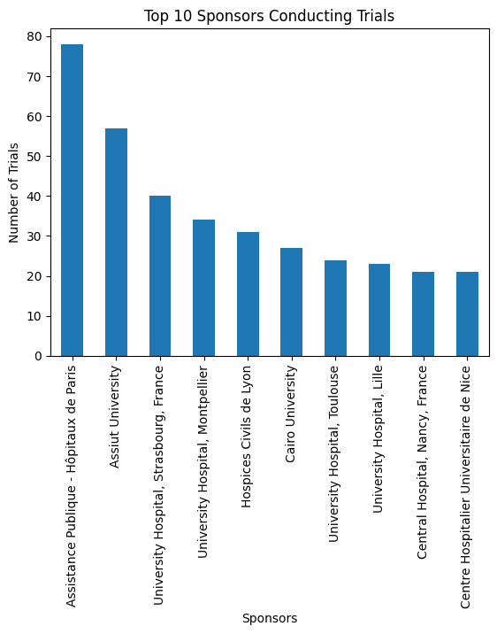
Sponsor & Organization Analysis
Top Sponsors Running COVID Trials
Sponsor data was explored to identify leading research institutions.
Insight:
Hospitals, universities, and pharma companies played key roles
Collaborative international sponsorship accelerated research outcomes

Slide 9
Tools & Methodology
Technologies Used
Python
Pandas for data cleaning and manipulation
Matplotlib for visualization
Exploratory Data Analysis techniques
Methodology
Data preprocessing
Missing value handling
Categorical distribution analysis
Visualization-based insight generation
Ref this link for code part of project :COVID CLINICAL TRIAL - Colab

Slide 10
Conclusion
Final Conclusion
COVID-19 clinical trials remain highly active worldwide
Most studies are still in recruiting or ongoing stages
Phase 2 and Phase 3 dominate research efforts
Global collaboration has been essential in pandemic response
Data-driven clinical trial analysis supports faster healthcare decision-making

